Slide 1
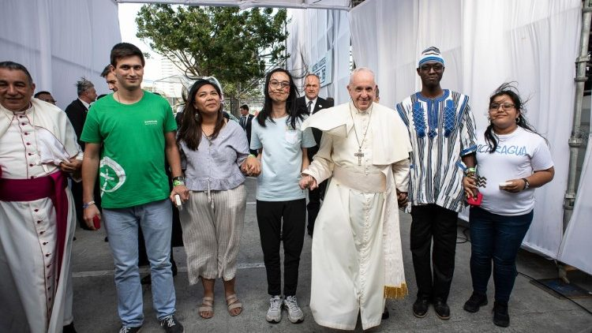
Fratelli Tutti(FT)-All are Brothers and Sisters by Pope Francis 03.10.2020.
The year 2023 marks the 60th anniversary of Pacem in Terris ( Pope John XXIII, 1963) and the 75th anniversary of Universal Declaration of Human Rights(UDHR). These contexts invite us to learn about the Social Teachings of the Church. Hence the summary of Fratelli Tutti is shared.

Slide 2
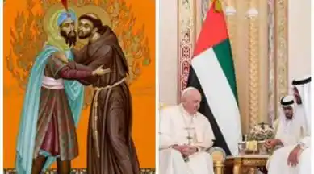
It is a call to love others as brothers and sisters, even when they are far from us (FT 1-2). Francis of Assisi used to address his brothers and sisters as Fratelli Tutti. His visit to Sultan Malik-el-Kamil, in Egypt is a gesture of his love beyond the borders (3). He became a father to all and inspired the vision of a fraternal society (4). Pope Francis says that his meeting with the Grand Imam Ahmad Al-Tayyeb in Abu Dhabi has encouraged him in publishing Fratelli Tutti (5).

Slide 3
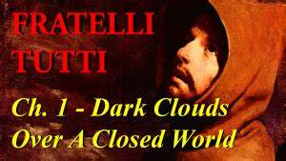
There are tendencies in our world that hinder the development or growth of universal fraternity:
Myopic nationalism under the guise of defending national interests creates new forms of selfishness without social sense (1​1).
Globalized society serves the economic interests and it makes us more like neighbours, but not as brothers and sisters (​12).
Native peoples lose their traditions, spiritual identity and moral integrity (​14).
People are denied the right to exist as well to have an opinion (​15).
Unproductive and not useful persons are disregarded and discounted (​18).

Slide 4
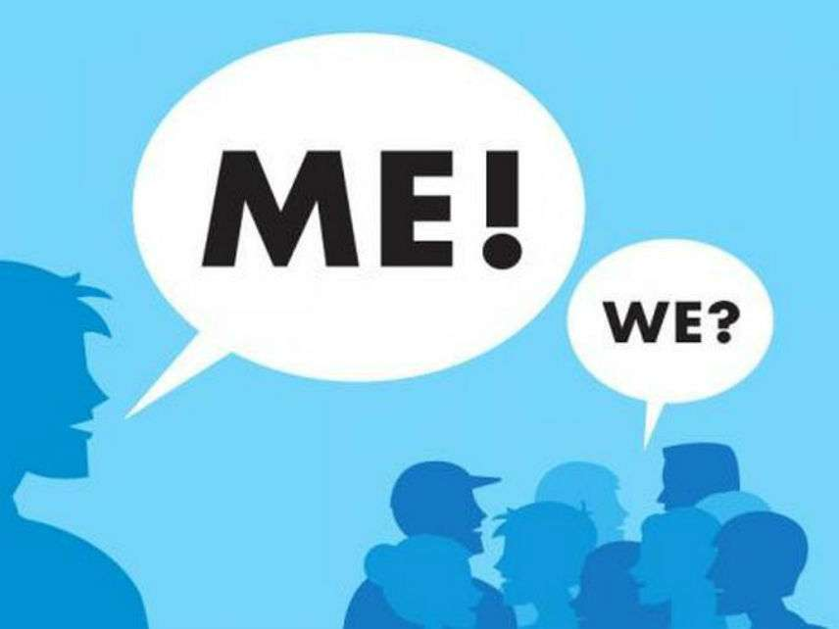
All are not considered equal in rights and dignity as declared in UDHR (​22)
There are new forms of slavery: subjugation of women, kidnapping for organs and human trafficking (​2​4)
War, terrorist attacks, racial or religious persecution indicate that the third world war is fought now but in piecemeal (​2​5).
There is temptation to raise walls in the heart and on the land, in order to prevent the encounter with other cultures and people (26). The excluded people become a terrain for mafias (28). In the absence of equitable distribution, the scientific progress has not led to a more humane future (29). The sense of belonging to a single human family is fading and there is globalized indifference (30).
It would be wonderful to rediscover the needs of the brothers and sisters who are in our orbit, as we discover faraway planets (31).

Slide 5
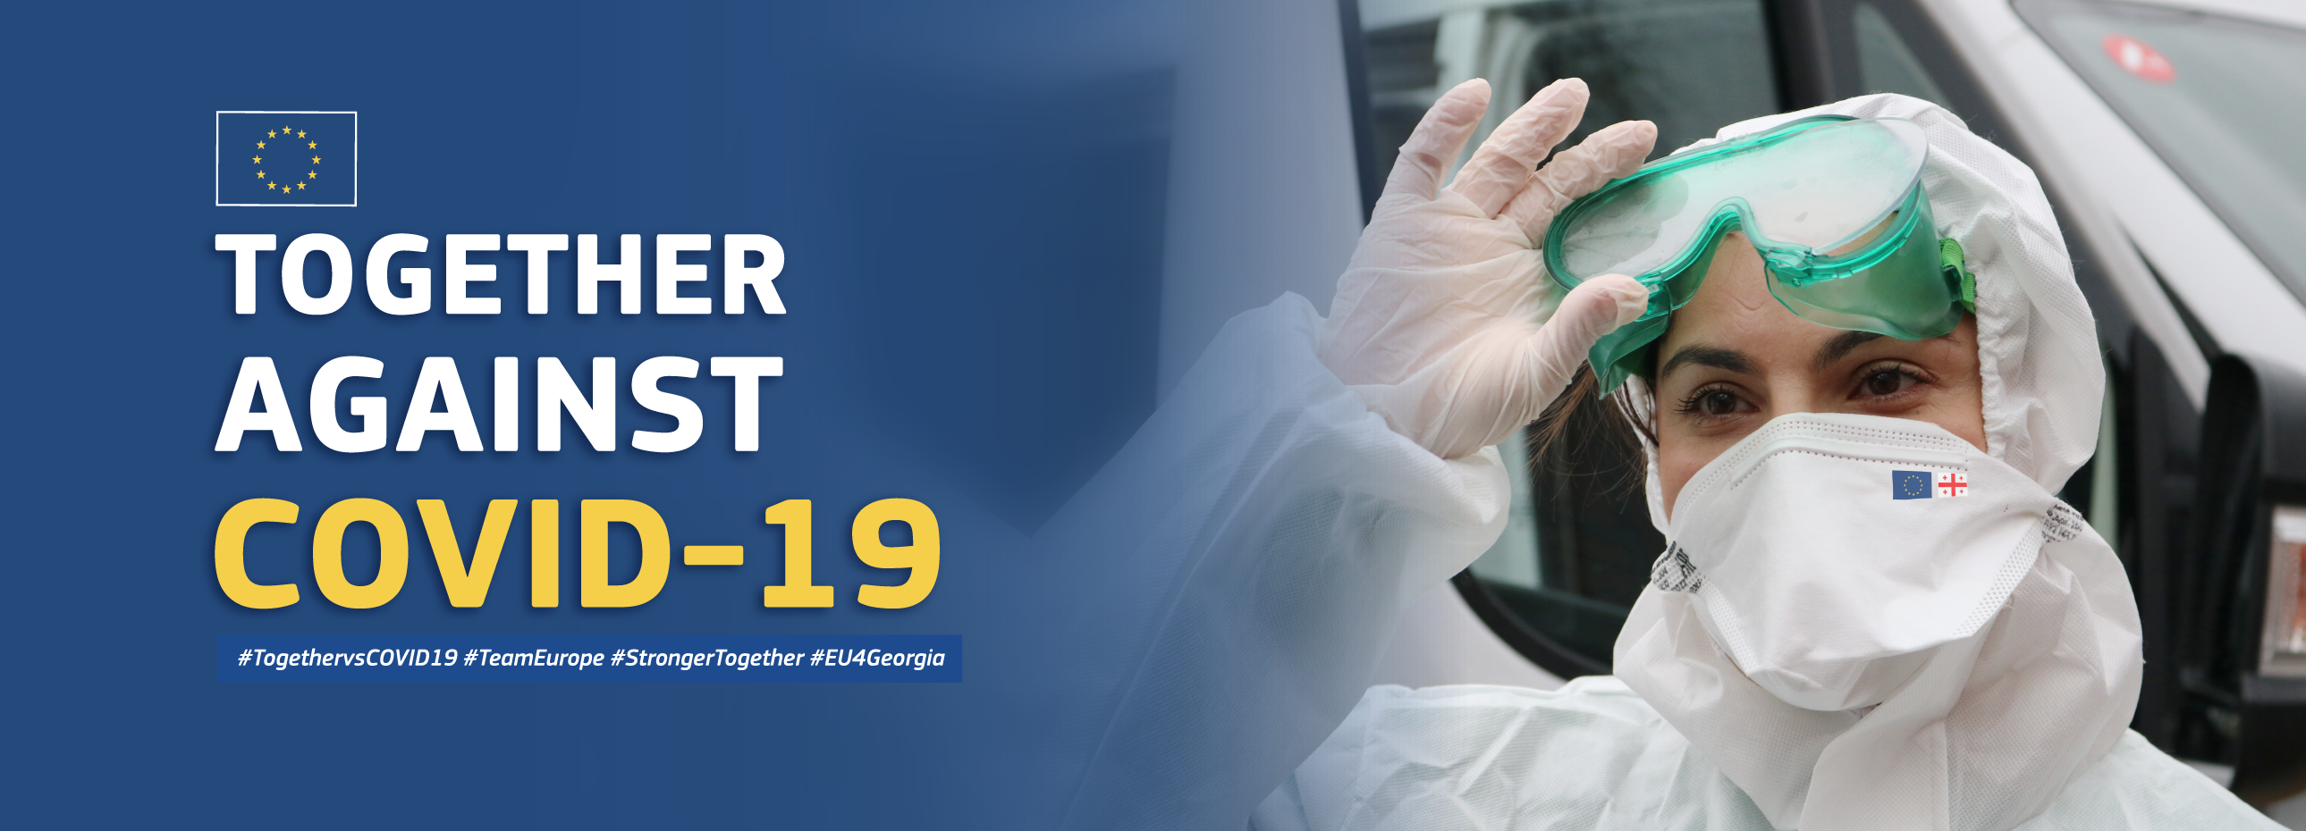
Through Covid pandemic we have realized that no one is saved alone but only together (32).
The global pandemic is a cry in rebellion against the harm human have done to the world (34). After this pandemic we should think no longer in terms of “them” and “those”, but only “us” (35). Otherwise the tendency ‘free-for-all’ will prove worse than any pandemic (36).

Slide 6
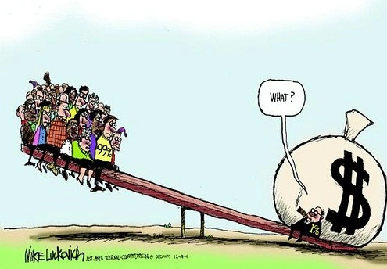
The countries preventing the arrival of migrants (​3​7). The people of the host countries having xenophobia (39).
The digital media robbing the privacy (​4​2) and spreading hatred and destruction (​43), fake news, fomenting prejudice and hatred (45).
Economically prosperous countries proposing as cultural models and the people in poor countries feeling inferior about their own culture (51).
Despite these dark clouds, there are many new paths of hope (​​54).

Slide 7
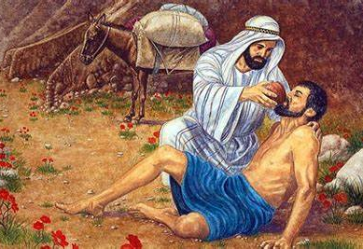
CHAPTER 2: A STRANGER ON THE ROAD
The parable of the Good Samaritan serves as a ray of light in the darkness (​56). The parable( who is my neighbour) takes us back to an earlier question, “Where is your brother Abel?” (Gen 4:9) (57)
A sick society is tempted to ignore others (64). Jesus’ parable summons us to rediscover our vocation as citizens of our respective nations and of the entire world, builders of a new social bond (66). The story of the Good Samaritan is constantly being repeated(71).

Slide 8

The story begins after the robbery having taken place (72). The religious personnel who do not help implies that faith in God is not a guarantee for a life of love and charity (74). Usually, the robbers and the passers-by have an alliance (75).
There was an inn and so the Samaritan could collaborate with innkeeper to care for the man; there has to be public facilities and we have to serve in solidarity with them (78). The Samaritan departed without expecting any recognition or gratitude; we are called to imitate his gesture of serving without expectation (79). In the parable Samaritan becomes a neighbour to the wounded Judean, crossing the cultural and historical barriers; we are also called to love beyond the boundaries (81). It means that love includes everyone (82). For Christians Jesus is present in every stranger (85).

Slide 9
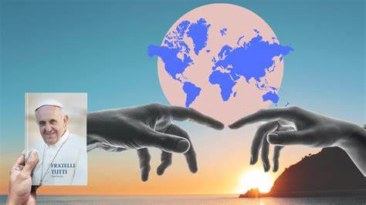
CHAPTER 3: ENVISAGING AND ENGENDERING AN OPEN WORLD
Love others: No one can experience the true beauty of life without relating to others, without having real faces to love (87). This love has to go beyond a group and the family (89). The monastic communities welcomed pilgrims, in order to encounter those outside their monastery (90). The greatest danger lies in failing to love (​9​2). Those abandoned or ignored by the society become an existential foreigner though they are born in the same country (​9​7). The persons with disabilities and elderly are treated as existential foreigners (​9​8).

Slide 10

Inclusive and Solidarity Society: The future is not of one-dimensional uniformity but inclusive (​100). Everyone, including the unproductive people, the poor, the un educated, the disabled, has the right to live with dignity, and to achieve integral development (107, 109, 110). In a situation when everything seems to disintegrate, solidarity has to be cultivated because we are responsible for those in need. The family is a privileged place for the education of solidarity (114-115). Solidarity is not only helping but it also means combatting the structural causes of poverty, inequality and the denial of human rights (116).

Slide 11
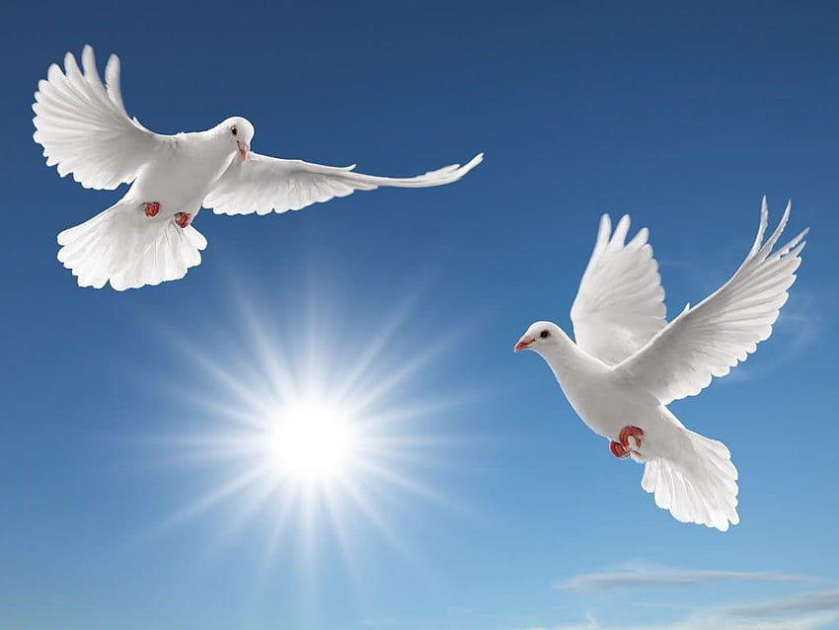
Common Destination of goods: The created goods of the world belong to all people. This is the first natural and inherent right. All other rights related to goods should not hinder this right (118-120). No one can be deprived of this right because of one’s place of birth, society, country or gender (121). Business activities should bring development, eliminate poverty and create jobs (​123).
World without borders: Each country also belongs to the foreigner. The goods and prosperity of a country should not be denied to a foreigner living there (124). While upholding the principle that all legitimately acquired debt must be repaid, the fulfilling of this obligation by the poor countries, should not compromise their very existence and growth (126). We have to aspire for a world that provides land, housing, and work for all. This is real peace (127).

Slide 12
CHAPTER 4
A HEART OPEN TO THE WHOLE WORLD: Migrants
Attitudes towards Migrants:
Respect the right of all individuals to find a place that meets their basic needs. Our response to the migrants are: Welcome, Protect, Promote, and Integrate those who arrive (​129); migrants have to be provided citizenship (131). We have to develop a global governance model with regards to the movements of refugees (132).
The immigrants are gift as well as blessing (133, 135). We have to welcome the migrants gratuitously (without counting the mutual benefit), because it is a good act (139). Only a social and political culture that readily and gratuitously welcomes others will have a future (141).

Slide 13
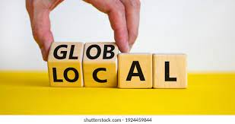
Local and global:
There must be a healthy tension between the global and the local, so as to avoid being abstractive or narrow (142). We have to cherish our roots and ancestral cultures and at the same time dialogue with other cultures (148). Viewing others as competitors or dangerous enemies affects relations between peoples in the same region and between the countries (152).

Slide 14
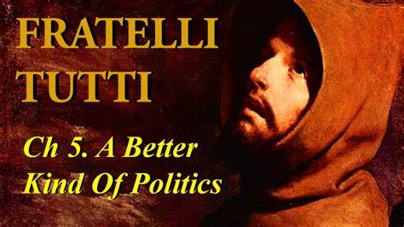
To foster a global community a better politics is required (154).
Both the populism that exploits the vulnerable people with emotional-empty promises to win their support, and the liberalism that serves the economic interests of the powerful, fail to create room for everyone (155).
People should have dignified life through work. There is no poverty worse than that which takes away work and the dignity of work (​1​62).
There is a need for a more efficient worldwide organization to resolve the problems plaguing the abandoned people (​1​65).
We need a politics that puts human dignity at the centre and on that pillar, builds the alternative social structures which are needed (​168).

Slide 15

Reform UNO: Today the transnational financial sectors are weakening the power of the States. Since States are becoming weak, there have to be strong-efficiently organised international institutions (172). There is a need to reform of the UNO and also the international economic institutions and finance (​​173).
Political Charity: The political charity promotes the fraternity and justice for all. Politics is the highest forms of charity when it seeks the common good (180, 182). The exercise of political charity means: changing the social conditions which cause suffering (186), finding effective solutions to social and economic exclusion (188), globalizing the most basic of human rights and elimination of hunger (189).

Slide 16
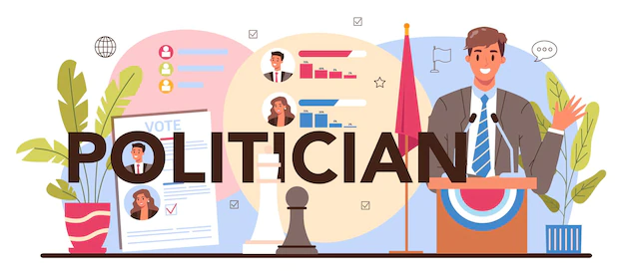
Duties of Politicians:
Politicians should be ready to listen to the views of others (190-191);
They have to practice love in their daily interpersonal relationships (193);
They must express tender love to the smallest, the weakest, the poorest (194).
Good politics combines love, hope and goodness that are present in human hearts (196).
They should not ask the questions “How many people voted for me?”, “How many had a positive image of me?” but should ask, “How much love did I put into my work?” “What did I do for the progress of our people?”

Slide 17
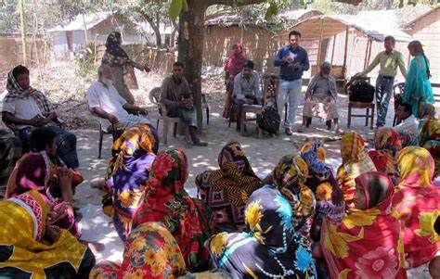
CHAPTER 6
DIALOGUE AND FRIENDSHIP IN SOCIETY
To encounter and help one another, we have to dialogue. Dialogue means approaching, speaking, listening, looking at, coming to know and understand one another, and finding common ground (​198).
Lack of dialogue means that the people are not concerned for the common good but they are interested in their power or imposing their own ideas (202).

Slide 18

For an authentic social dialogue there has to be:
The ability to respect the other’s point of view (203).
Interdisciplinary outlook to become open to the views of others (204).
The internet-based media has to help the pursuit of the whole truth and not to bring out the weaknesses and the worst in people (205).
Search for truth which is based on the universally valid principles and fundamental rights (206).
The respect for human dignity in all circumstances (​2​13).

Slide 19

Encounter for a New culture:
There has to be a many-faceted polyhedron society where differences coexist even amid disagreements and reservations. (​2​15).
Culture is deeply embedded within the people. The desires, the interests and ultimately the way they live of lives of people are expressed in culture (​2​16).
The social covenant (218) and the cultural covenant promote respect for diversity (​​219-220).
We have to cultivate kindness (222) which in turn can transform the lifestyles, relationships and the ways of discussing and comparing of ideas (224).

Slide 20
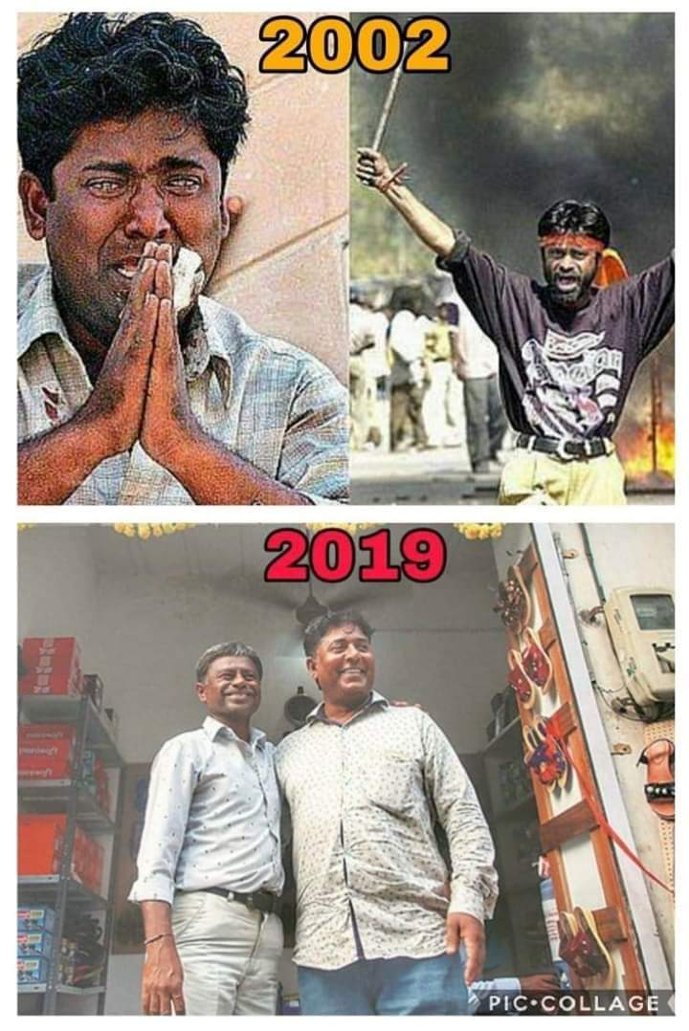
CHAPTER 7
PATHS OF RENEWED ENCOUNTER
Throughout the world there is a need for peace and peacemakers (225).
Renewed encounter of those who have been enemies strive for a new synthesis for the good of all (​226).
Truth, justice and mercy are inseparable for building peace(227).
The Bishops of South Africa have pointed out that true reconciliation is achieved proactively (​2​29).
Inequality and lack of integral human development make peace impossible (​2​35).
Ansari(Muslim) and Ashoke(Hindu)becoming friends in India

Slide 21
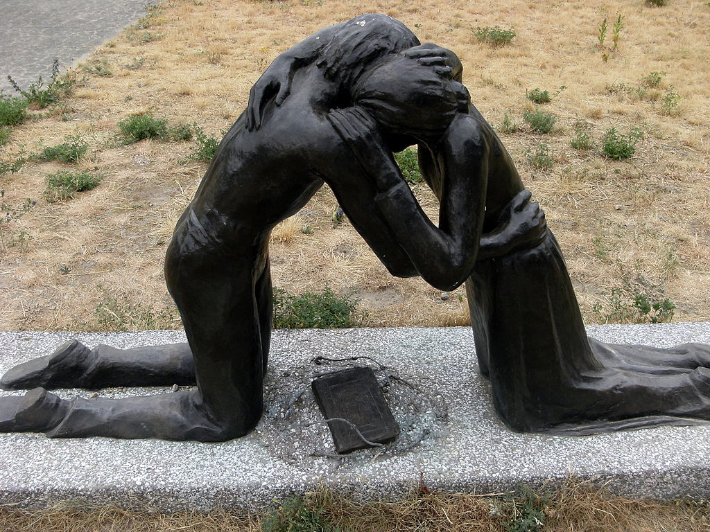
There are those who say that the problems are part of society and promoting reconciliation is a sign of weakness (​2​36).
But forgiveness and reconciliation are central themes in Christianity and in other religions as well (​2​37).
True love for an oppressor means, seeking ways to make him cease his oppression (​2​41).
Authentic reconciliation does not flee from conflict (​244). Forgetting is never the answer (​246). Those who truly forgive do not forget (​252).
War and the death penalty introduce new elements of destruction in the society (255).
There is no rational for just war. The church upholds the position, Never again war! (​2​58).
Ultimately eliminating all nuclear weapons becomes a moral and humanitarian imperative. The death penalty is simply inadmissible (263). A life sentence is a secret death penalty (​268).

Slide 22
CHAPTER 8
RELIGIONS AT THE SERVICE OF FRATERNITY IN OUR WORLD
Dialogue among religions seeks to establish friendship, peace, and harmony, and to share spiritual-moral values and experiences (​​271). God is the father of all and this calls for budling fraternity (272). The denial of this transcendent image of persons leads to totalitarianism (273).
The effort to seek God with a sincere heart, helps us to recognize one another as truly brothers and sisters (​274). The Church does not remain on the side-lines in the building of a better world. Apart from the works of charity and education, the Church works for the advancement of humanity and of universal fraternity (​​276).

Slide 23
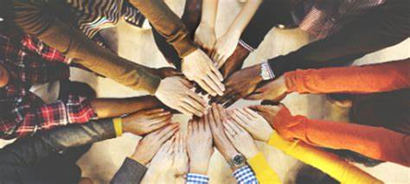
The Church esteems the ways in which God works in other religions. People of other faith drink from their sources. For the Christians the wellspring of human dignity and fraternity is in the Gospel of Jesus Christ (277). For many Christians, Mary is the mother. She gives birth to a new world, where all of us are brothers and sisters (​2​78).
We Christians ask for religious freedom for believers (​279), unity within the Church and between different Christian confessions (​2​80) and peace between religions (2​​81).
As religious leaders, we are called to be true people of dialogue and an artisan of peace (284).
Christian identity

Slide 24
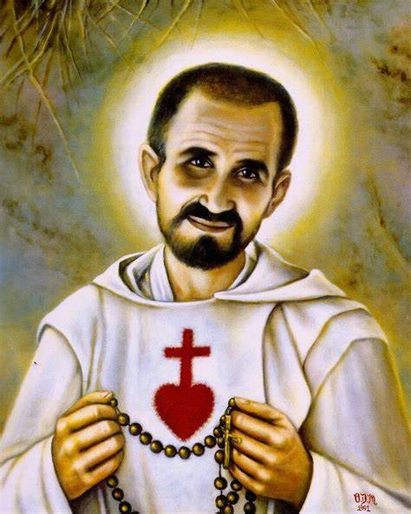
AN APPEAL
In the name of God and in the names of all persons of goodwill, we declare the adoption of a culture of dialogue as the path; mutual cooperation as the code of conduct; reciprocal understanding as the method and standard (285).
For these reflections found in Fratelli Tutti the inspirations are from Martin Luther King, Desmond Tutu, Mahatma Gandhi and many others(286). Blessed Charles de Foucauld wanted to be the universal brother by identifying himself with the poor and the abandoned in African desert. (​2​87).

Slide 25
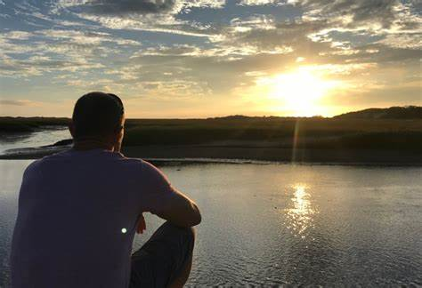

Question For Reflection:
What can religious do to realise the vision of FT?

