Slide 1

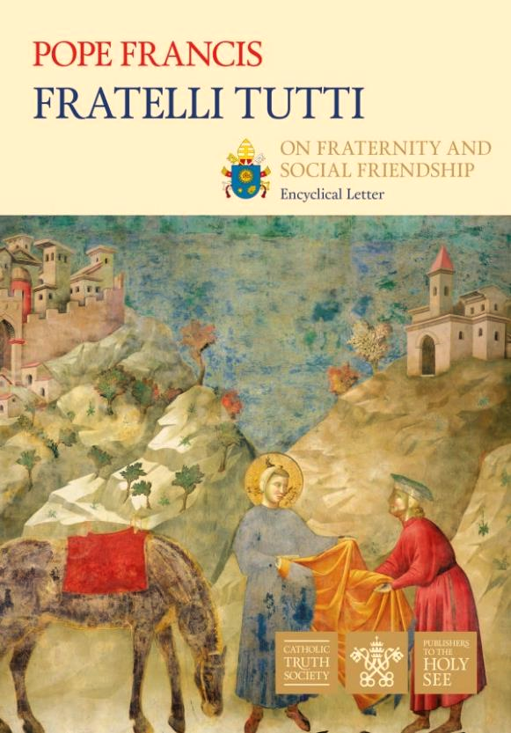
ALL
WE
ARE
SISTERS
AND
BROTHERS!

Slide 2
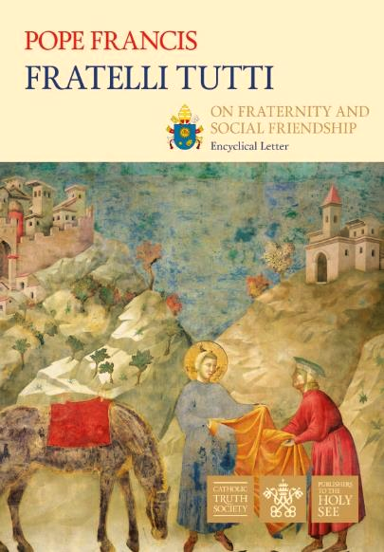
It is my desire that, in this our time, by acknowledging the dignity of each human person, we can contribute to the rebirth of a universal aspiration to fraternity. Fraternity between all men and women. FT 8

Slide 3
“How important it is to dream together… By ourselves, we risk seeing mirages, things that are not there. Dreams, on the other hand, are built together”.
Let us dream, then, as a single human family, as fellow travellers sharing the same flesh, as children of the same earth which is our common home, each of us bringing the richness of his or her beliefs and convictions, each of us with his or her own voice, brothers and sisters all.
FT 8

Slide 4
Recognizing that all people are our brothers and sisters, and seeking forms of social friendship that include everyone, is not merely utopian.
It demands a decisive commitment to devising effective means to this end. Any effort along these lines becomes a noble exercise of charity. FT 180
Let us remember the Christians of the early church!

Slide 5

They were women and men coming from different cultures and speaking different languages!
The Christians of
the early church
found ways to live as sisters and brothers
They were:
  Hebrews
  Samaritans
  Greeks
  Romans
  Ethiopians
  Phoenicians
  …

Slide 6
They worked in various professions and belonged to different social ranks.
The Christians of
the early church
found ways to live as sisters and brothers
They were:
  fishermen
  tax collectors
  traders
  militaries
  slaves
  levites
  tent makers
  …

Slide 7
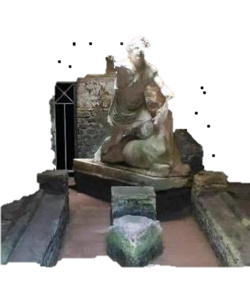
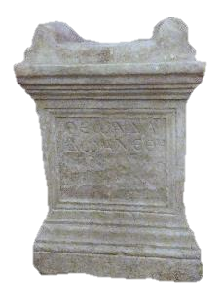
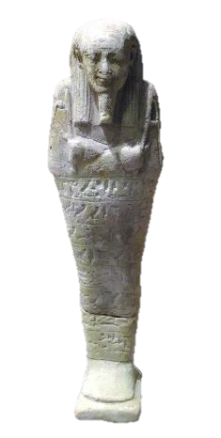
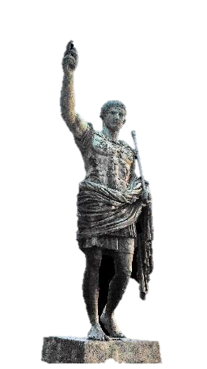
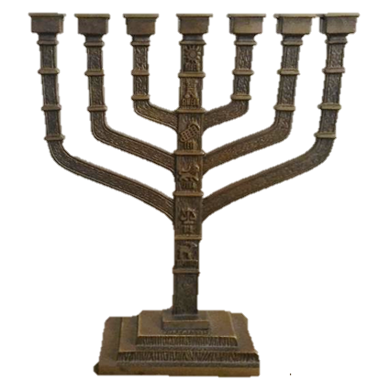
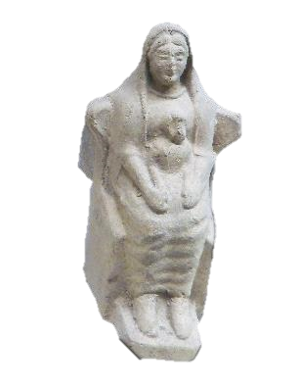
They had various religious experiences and backgrounds.
The Christians of
the early church
found ways to live as sisters and brothers
Greek
divinities
Egyptian
divinities
Mithra cult
Imperial
cult
Roman
divinities
Judaism

Slide 8
Guided by the Holy Spirit, they lived the differences as mutual enrichment and as a gift.
The Christians of
the early church
found ways to live as sisters and brothers
They witnessed the Gospel of the reign of God through the practice of charity, hospitality and solidarity.
They fulfilled the mission of Jesus Christ, the risen one.

Slide 9
Each particular group becomes part of the fabric of universal communion and there discovers its own beauty.
All individuals, whatever their origin, know that they are part of the greater human family, without which they will not be able to understand themselves fully. FT 149
To see things in this way brings the joyful realization that no one people, culture or individual can achieve everything on its own: to attain fulfilment in life we need others. FT 150
Today, we are challenged to live as sisters and brothers of the human family

Slide 10
The urgent challenge to protect our Common Home includes a concern to bring the whole human family together to seek a sustainable and integral development, for we know that things can change. LS 13
Today, we are challenged to live as sisters and brothers of the human family

Slide 11
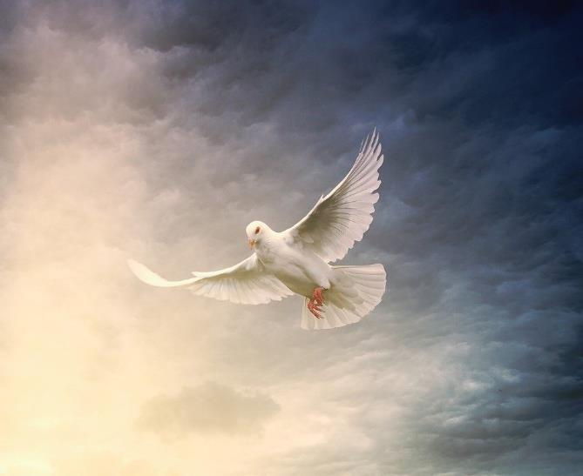


Come, Holy Spirit,
  Show us your beauty,
  reflected in all the peoples of the earth,
  so that we may discover anew
  that all are important and all are necessary,
  different faces of the one humanity
  that God so loves.
Holy Spirit, Come to Us

Slide 12


Come, Holy Spirit,
  Help us to transcend the barriers of geography and distance!
  Help us to encounter all people as sisters and brothers.
  Help us to live as sisters and brothers in caring for our Common Home.
Holy Spirit, Come to Us

Slide 13
AMEN

