Slide 1
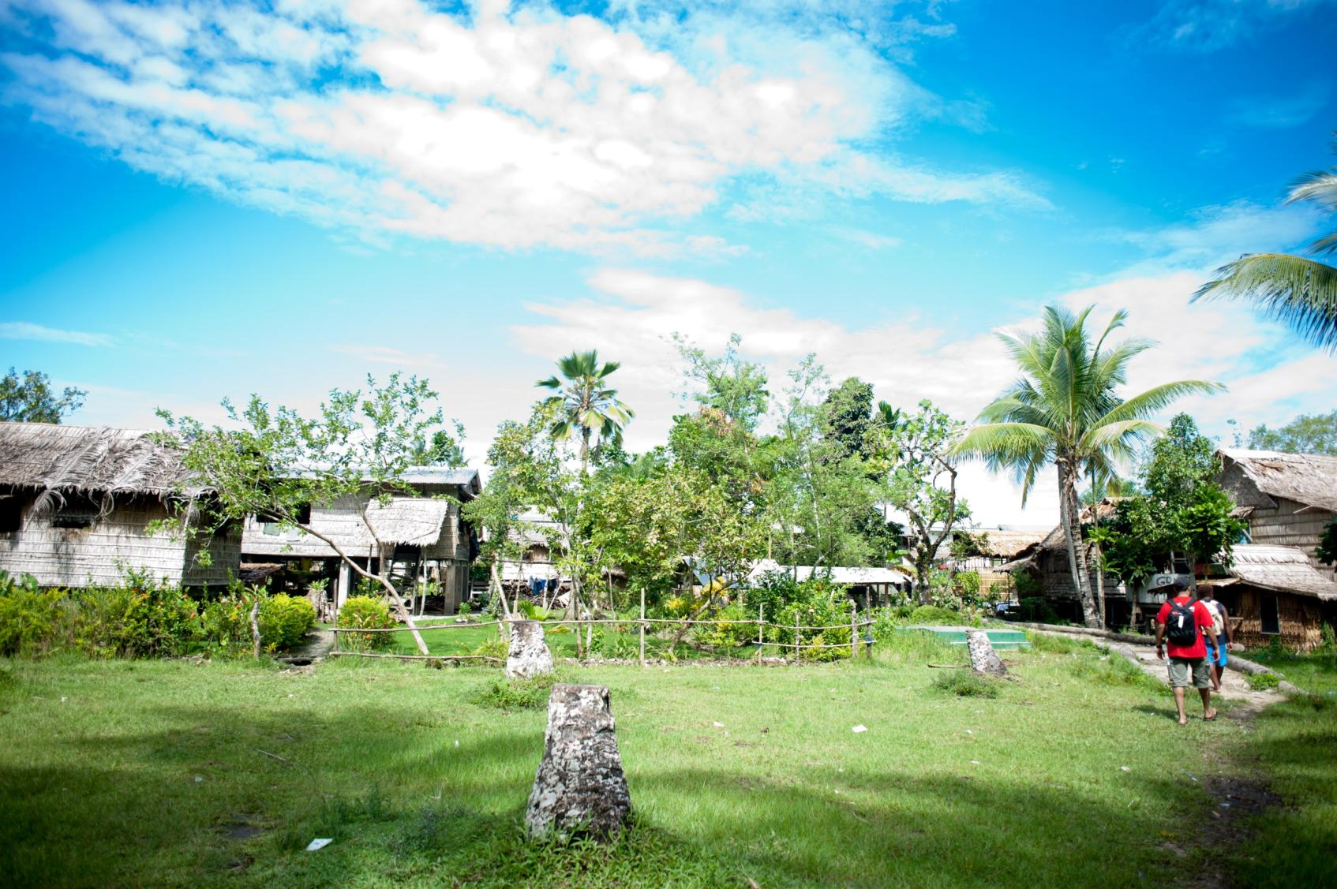

Laudato Si’
Care of our Common Home
A reflection on the Pope’s encyclical
Photo: Adrian Heke

Slide 2
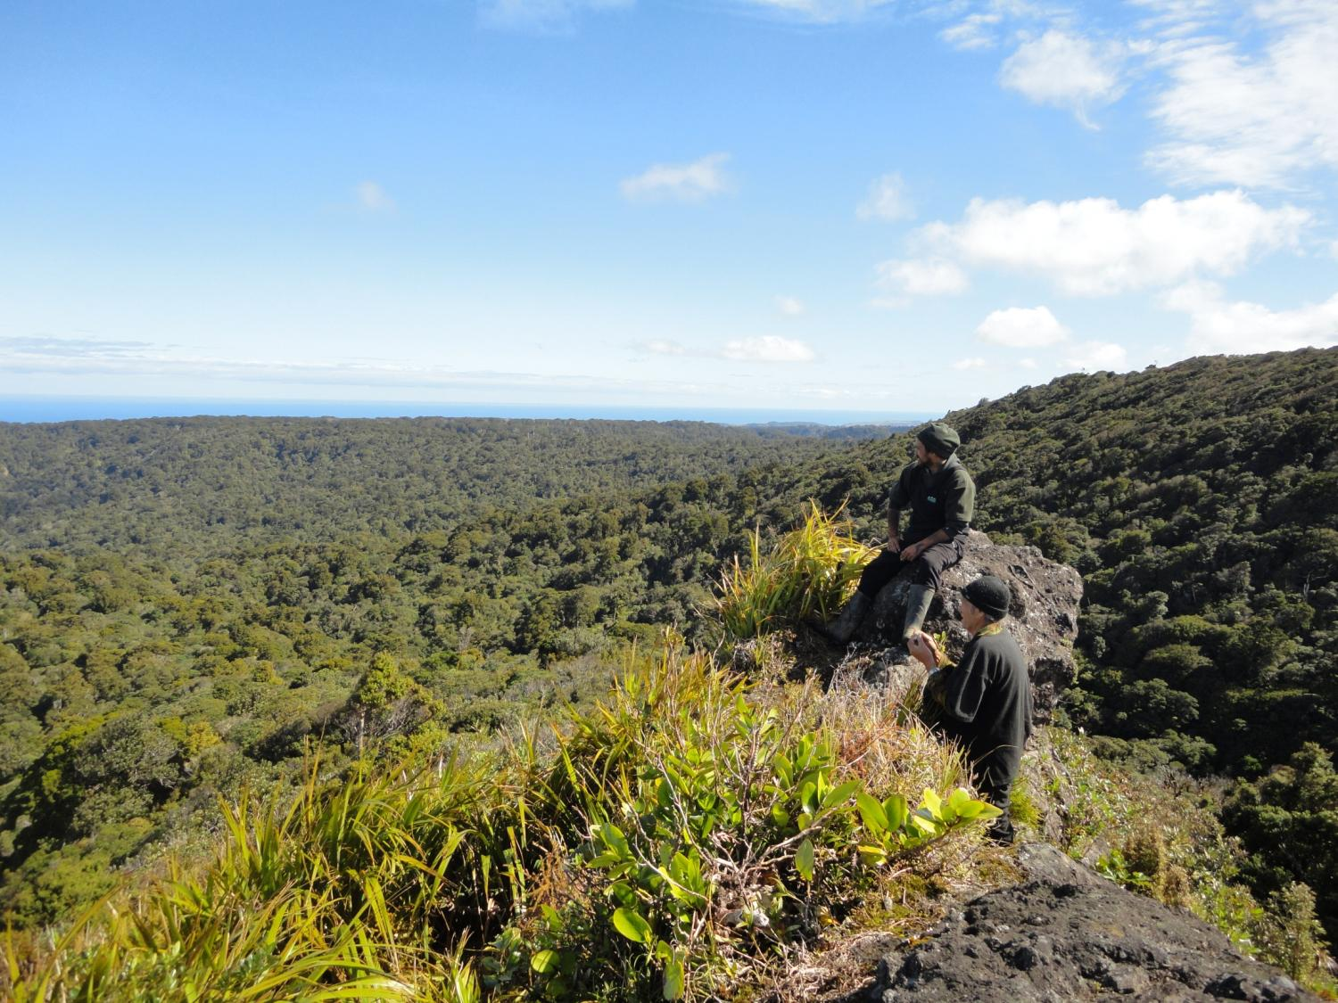
The entire material universe speaks of God’s love, his boundless affection for us.
# 84

Slide 3
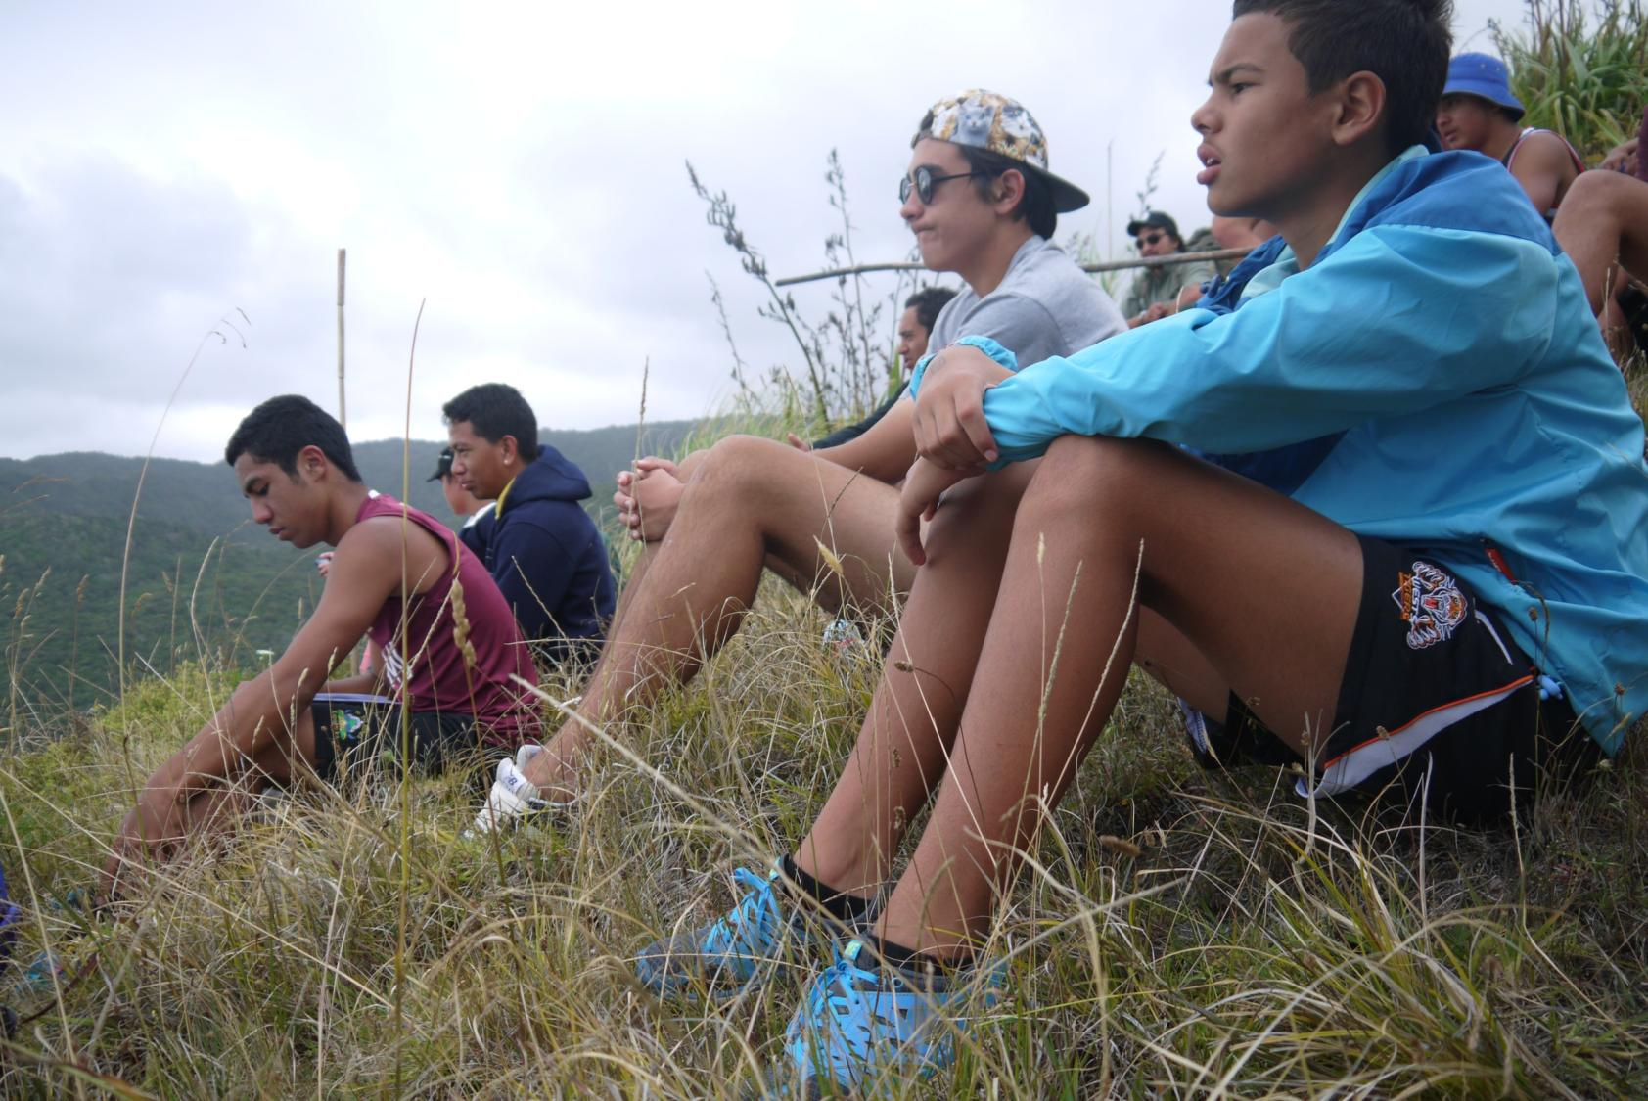
...nature is a constant source
of wonder and awe. #85

Slide 4
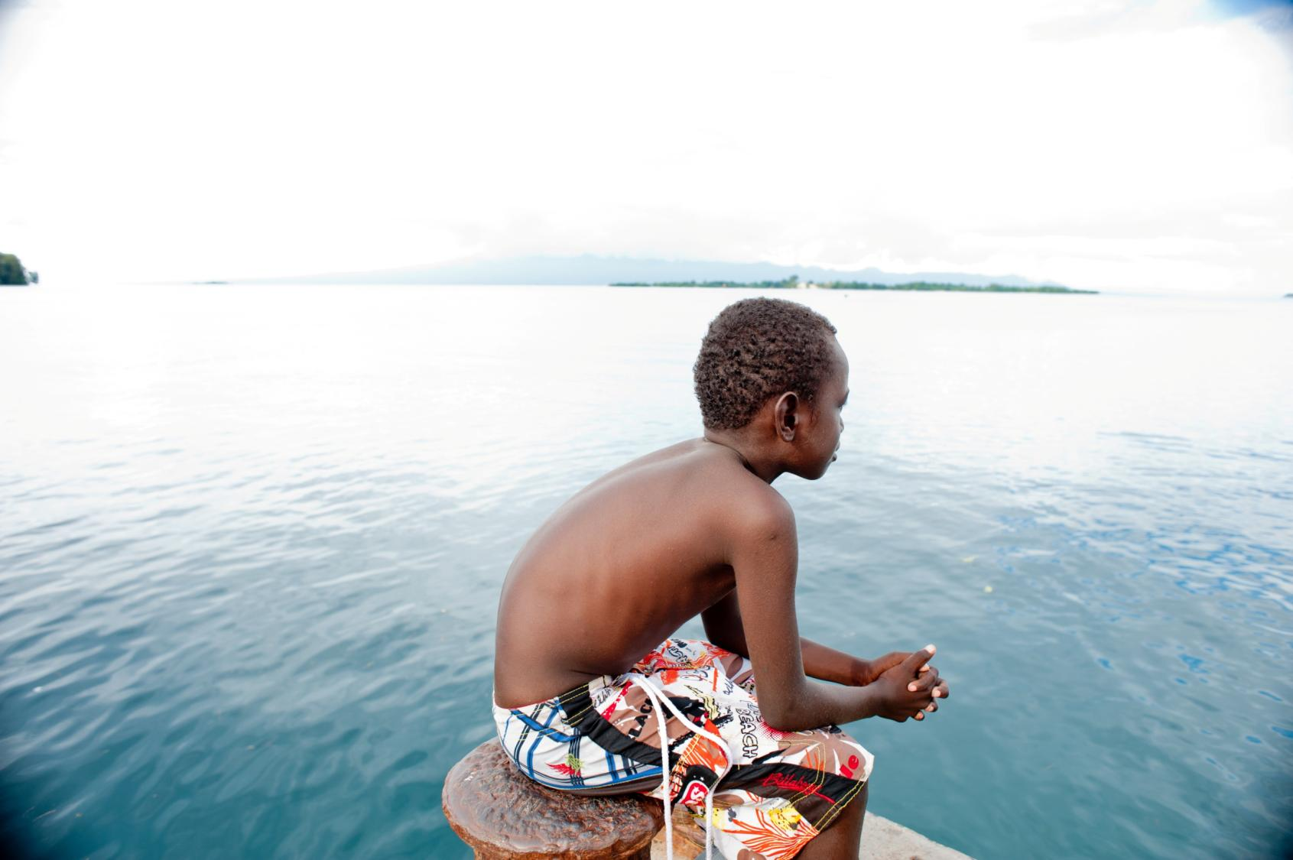
When we can see God reflected in all that exists, our hearts are moved to praise the Lord for all his creatures and to worship
in union with them.
#57

Slide 5
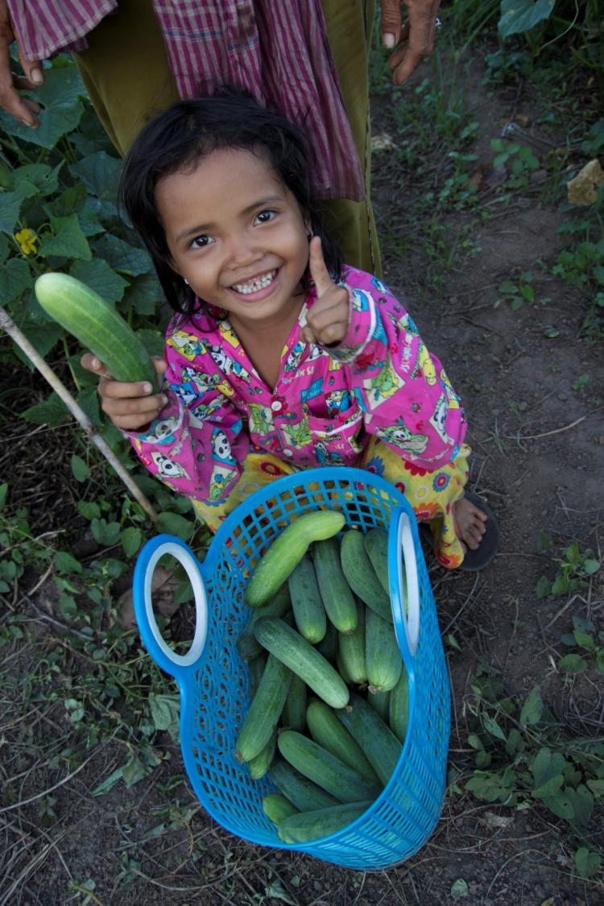
Saint Francis of Assisi reminds us
that our common home is like a sister with whom we share our life…
#1

Slide 6
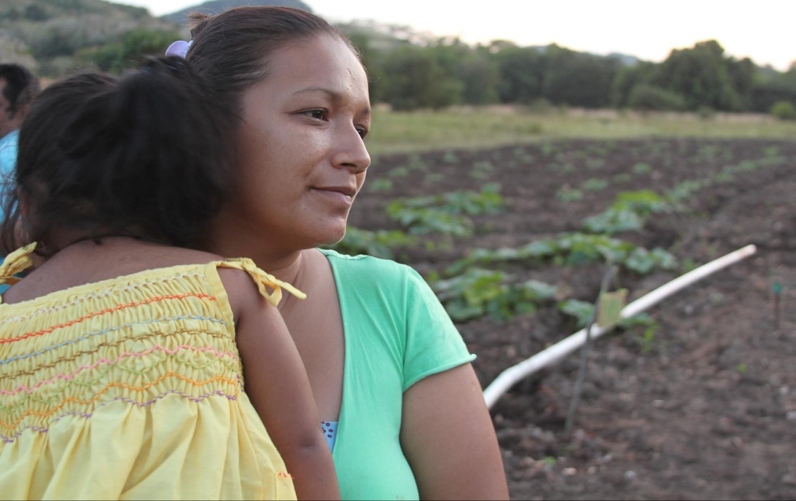
…and a beautiful mother who opens her arms
to embrace us. # 1

Slide 7
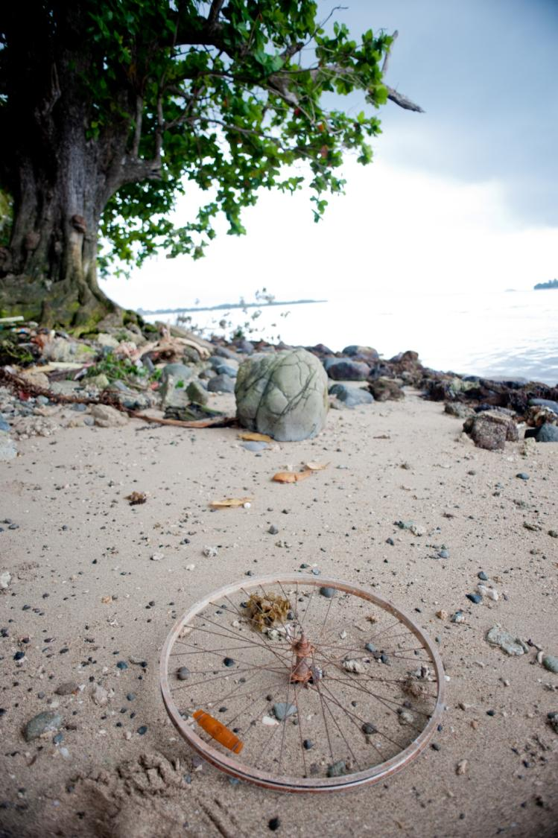
This sister now cries out to us because of the harm we have inflicted on her by our irresponsible use and abuse of the goods with which God has endowed her.
# 2
Photo: Adrian Heke

Slide 8
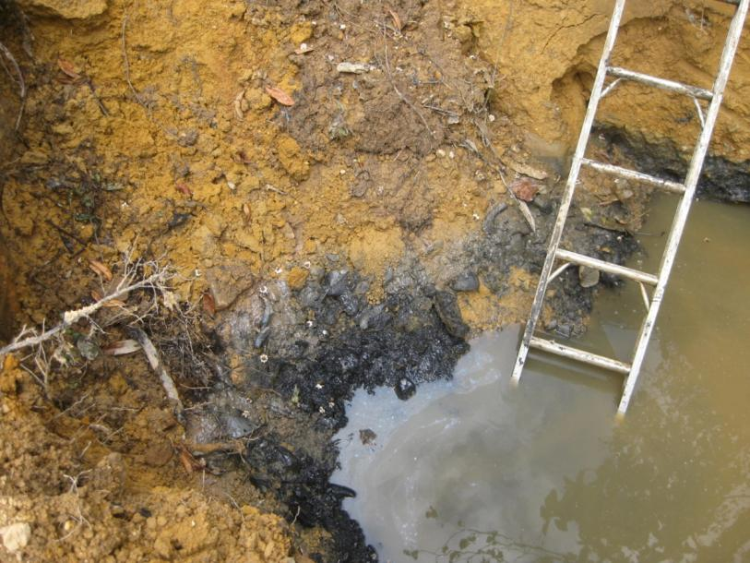
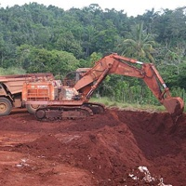
Fiji – SEEP- Social Empowerment Education Programme
The earth, our home, is beginning to look more and more like an immense pile of filth.
#21
https://ramumine.wordpress.com

Slide 9
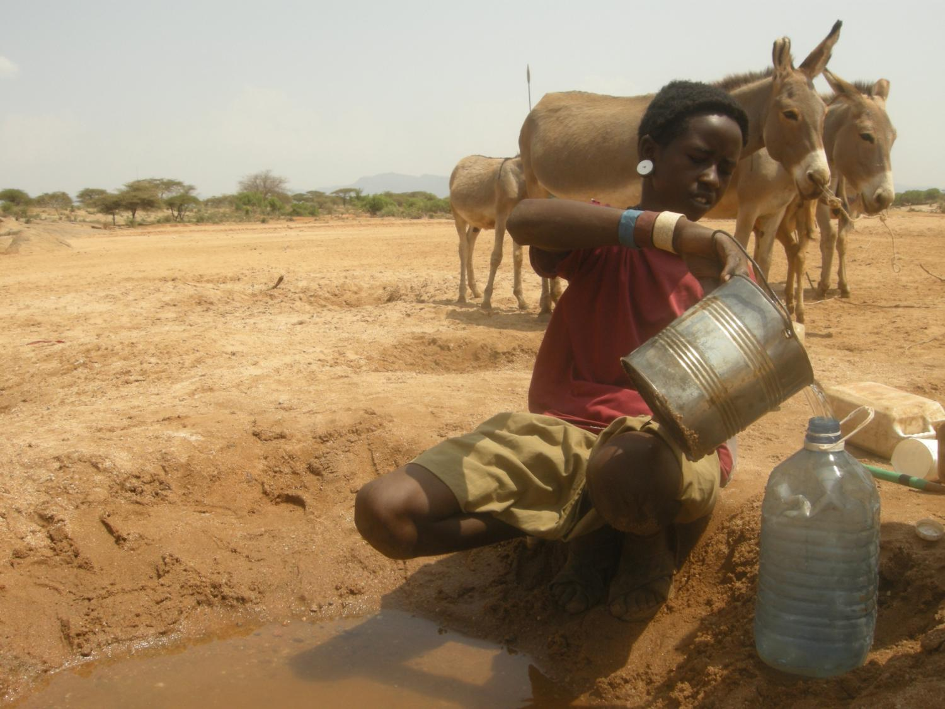
Climate change is a global problem with serious implications, ... it represents one of the principal challenges facing humanity today.
# 25

Slide 10
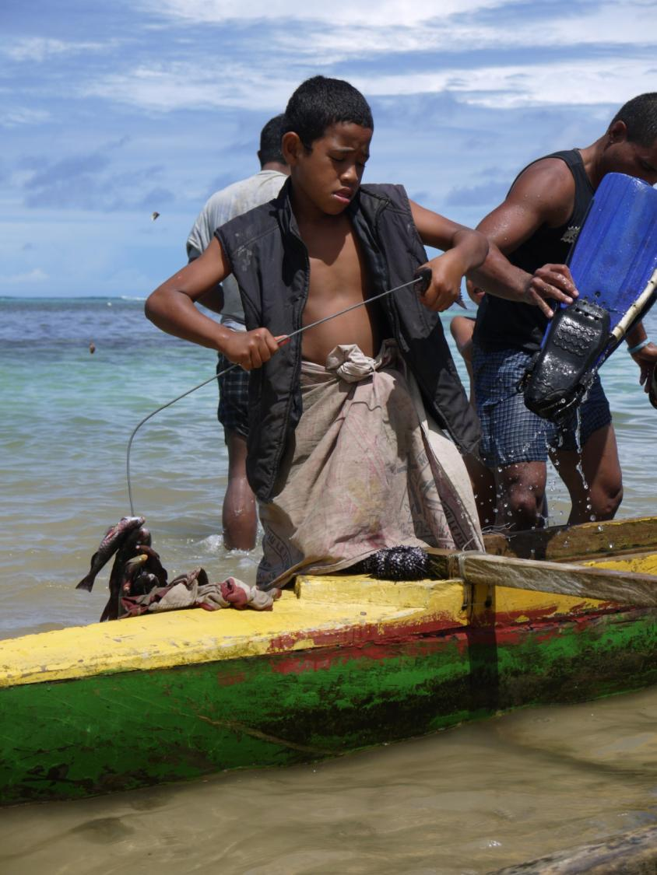
The depletion of fishing reserves especially hurts small fishing communities without the means to replace these resources...
#48

Slide 11
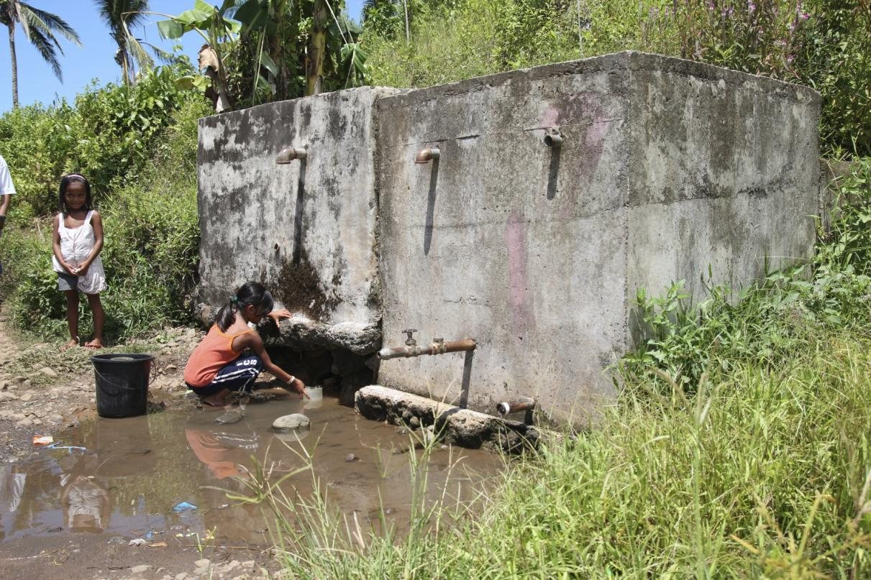
Water pollution particularly affects the poor who cannot buy bottled water... # 48

Slide 12
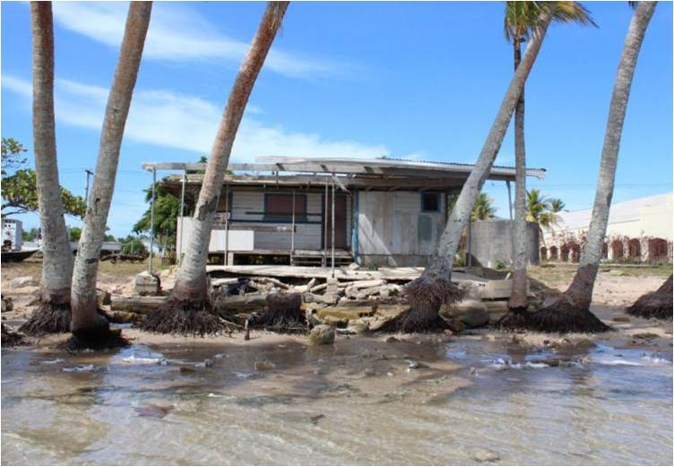
Rises in sea level mainly affect impoverished coastal populations who have nowhere else to go
#48

Slide 13
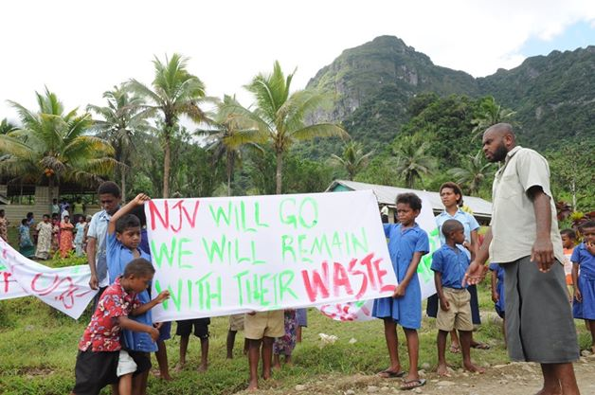
Environmental deterioration and human and ethical deterioration are closely linked. Many people will deny doing anything wrong...
#56
Fiji – SEEP Social Empowerment Education Programme

Slide 14
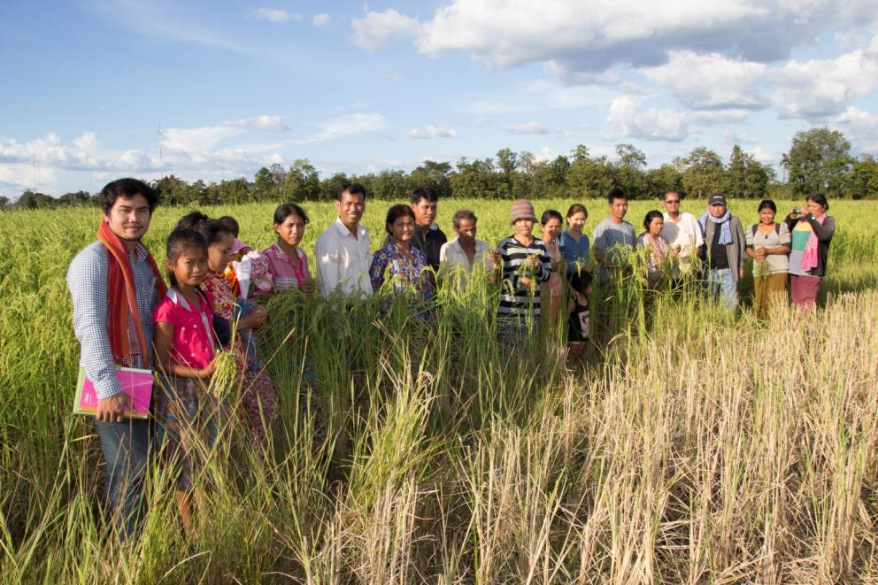
…the principle of the common good immediately becomes a summons to solidarity with the poorest of our brothers and sisters.
# 158

Slide 15
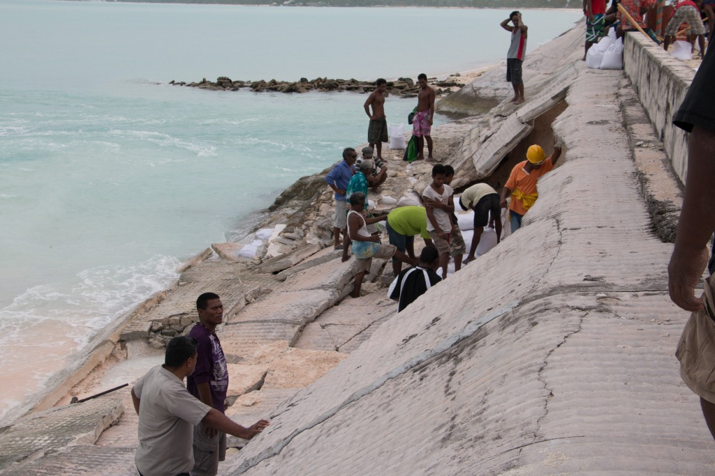
(We are faced with) one complex crisis which is both social and environmental. #139

Slide 16



An awareness of the gravity of today’s cultural and ecological crisis must be translated into new habits. # 206

Slide 17
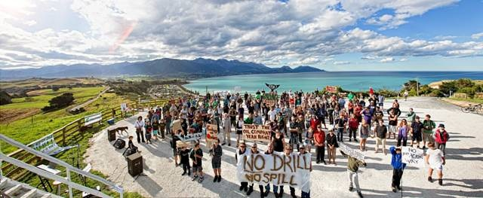
No Drill Kaikōura
The ecological conversion needed to bring about lasting change is also a community conversion. # 219

Slide 18
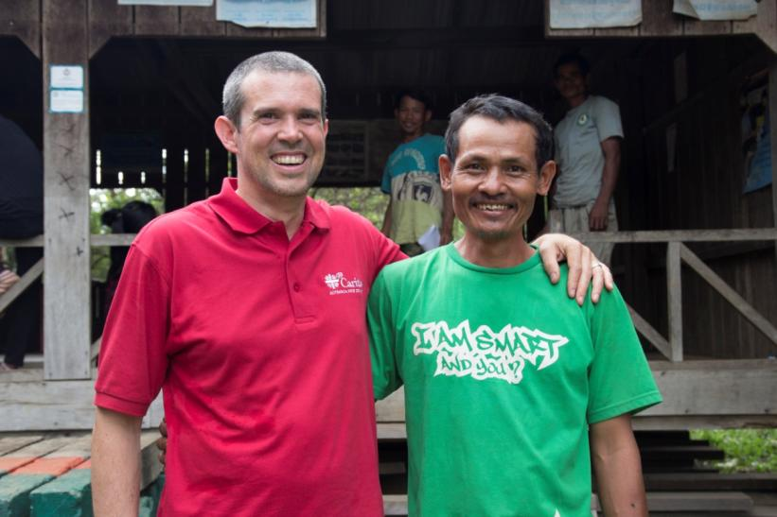
We must regain the conviction that we need one another, that we have a shared responsibility for others and the world.
# 229

Slide 19
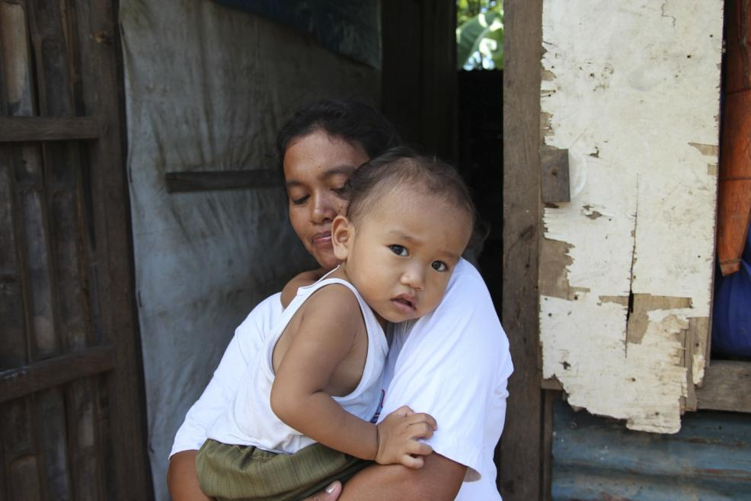
All is not lost. Human beings, while capable of the worst, are also capable of rising above themselves, choosing again what is good.
# 205

Slide 20
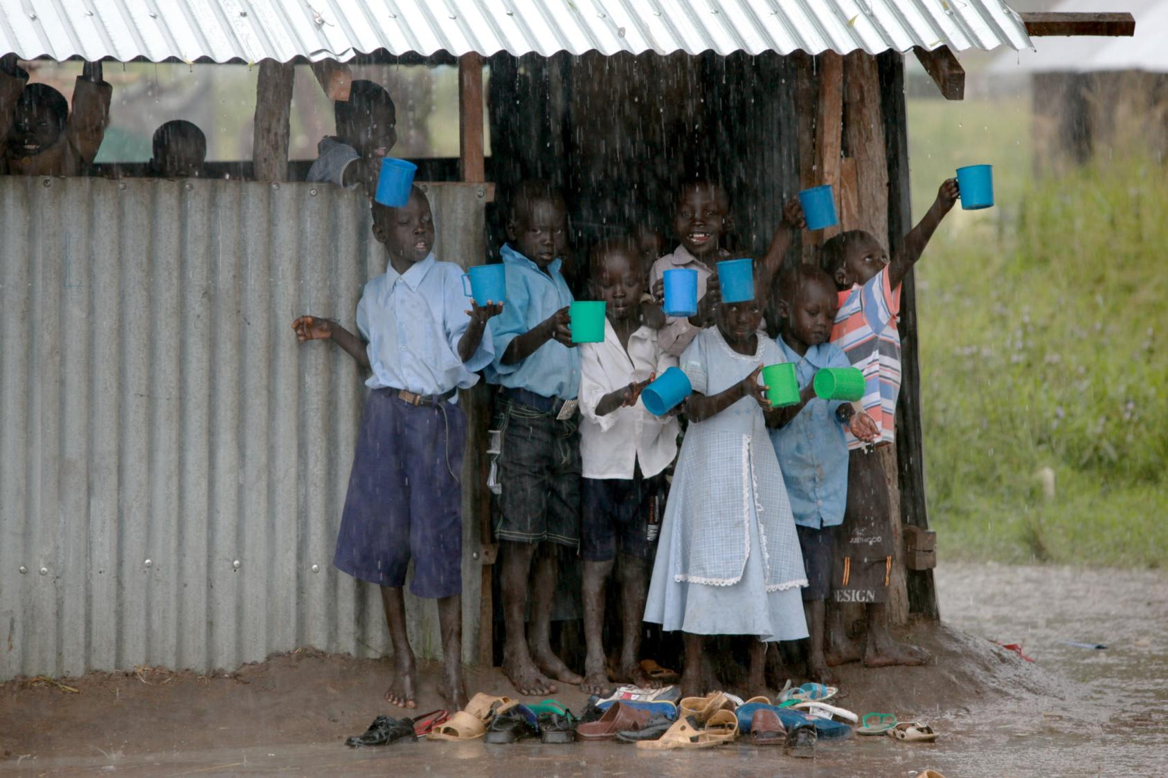
May our struggles and our concern for this planet
never take away the joy of our hope.
#244
Photo: Caritas Internationalis

Slide 21
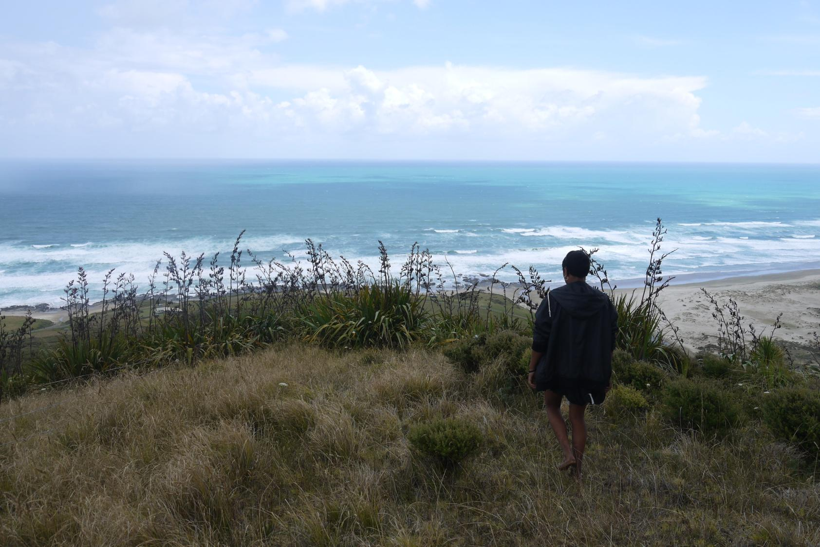
All powerful God,
you are present in the whole universe
and in the smallest of your creatures.
You embrace with your tenderness
all that exists.

Slide 22
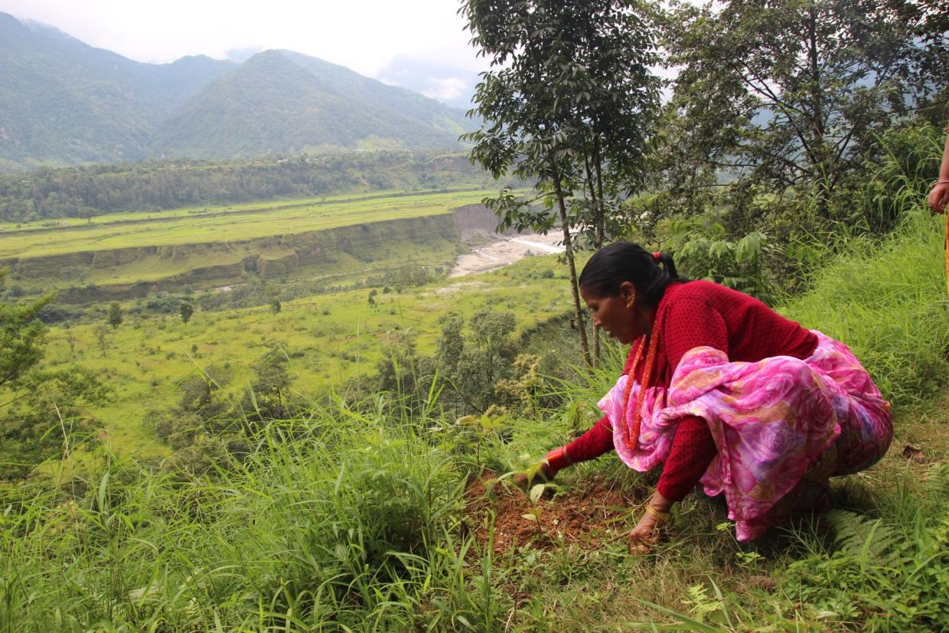
Pour upon us the power of your love,
that we may protect life and beauty.
Fill us with your peace, that we may live
as brothers and sisters, harming no one.

Slide 23
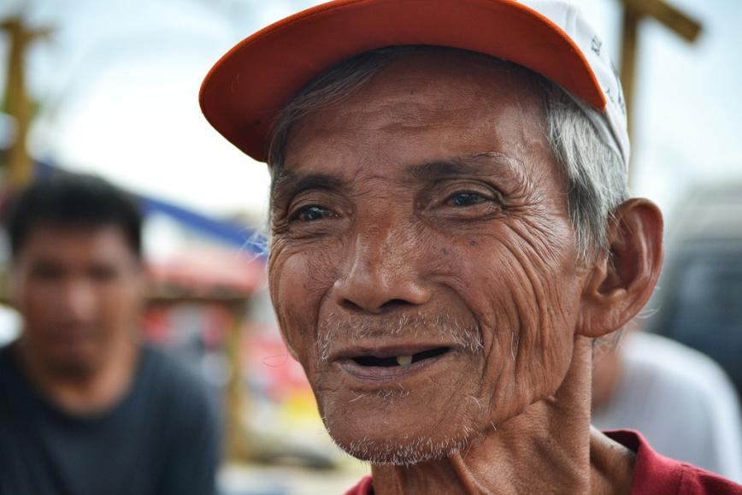
Teach us to discover the worth of each thing,
to be filled with awe and contemplation,
to recognise that we are profoundly united
with every creature
as we journey towards your infinite light.

Slide 24
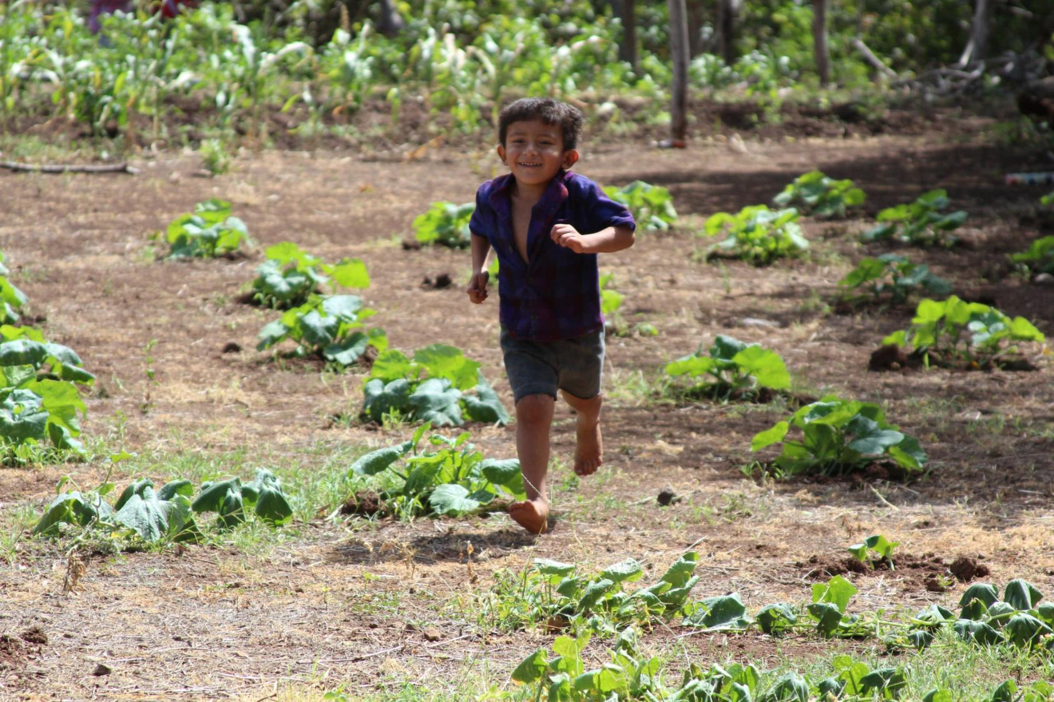
We thank you for being with us each day.
Encourage us, we pray, in our struggle
for justice, love and peace.

Slide 25

Photo Credits: Adrian Heke, Caritas Internationalis, Caritas Aotearoa New Zealand and Fiji Social Empowerment and Education Programme.
Please contact Caritas Aotearoa New Zealand if you wish to use any images in this powerpoint for another purpose.

